Slide 1
Lead Scoring Case Study
Problem Statement : An education company named X Education sells online courses to industry professionals. On any given day, many professionals who are interested in the courses land on their website and browse for courses. X Education has appointed us to help them select the most promising leads, i.e. the leads that are most likely to convert into paying customers. The company requires you to build a model wherein we need to assign a lead score to each of the leads such that the customers with higher lead score have a higher conversion chance and the customers with lower lead score have a lower conversion chance. The CEO, in particular, has given a ballpark of the target lead conversion rate to be around 80%

Slide 2
Steps for Data Understanding and Cleaning :
We are removing few of the columns which doesn't have proper existence in their values. e.g. either Yes or No or negligible count for the secondary value
Dropped further columns which has 46% of data NULL
Dropping Country as 95.77% is India from the Non-NULL values
Columns having values count of less than 200 we are going to merge all of those to a single value as ##Others e.g. LAOthers, LAN_Others and rest wherever applicable.
For Specialization column we can see NULL & Select values adds up to 3380 which is approx. 30% of the total population. Moreover please note NULL and Select can be considered as identical. Hence merging all those to a new value as Unknown_Specialization
More than 60% for "How did you hear about X Education" is Select and we can't manipulate this with any other ways like random variable or anything else. Hence dropping this too
Now for Occupation we will club Student/Other/Housewife/Businessman in one group due to the low count and the NULL to Unknown to maintain the difference
Again for "What matters most to you in choosing a course" the variance of the values for Other AND Flexibility & Convenience is negligible and this column will not make and sense or difference in our analysis. Hence dropping this too.
40% of the City is Unknown hence dropped that too
For the columns TotalVisits & Page Views Per Visit are having around 137 rows with NULL values which is very less in comparison to the whole dataset. Hence, we are dropping those NULL records

Slide 3
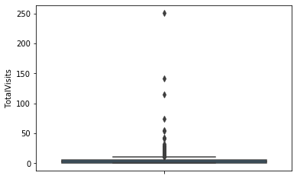
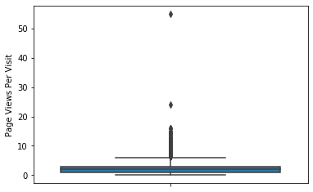
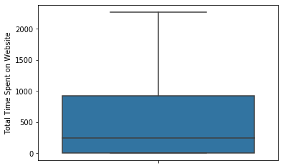
Outliers Analysis :
Looking into the boxplots we are considering to remove the outliers for TotalVisits & Page views Per Visit with 0.05 %

Slide 4
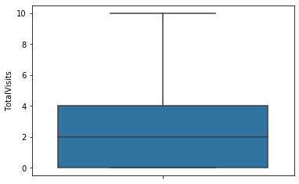
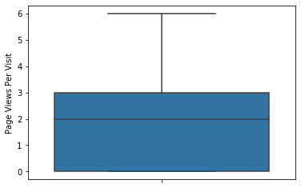
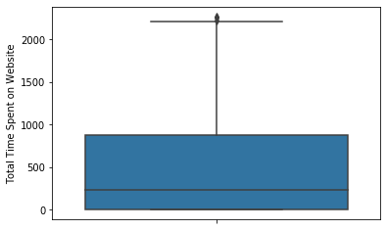
Post Outliers Treatment :
We observed Prospect ID & Lean Number is UNIQUE and can be the used as Identity in future purpose. Hence, preserving these columns for future use.
Current Lead Conversion rate post Outliers treatment is 38%

Slide 5
Steps for Data Preparation:
Conversion of column data with binary values
Dummy variable creation
Initially we have manipulated the data on few columns with "Others/Unknown" values hence, deleting "Others/Unknown" dummy column to be clean and simple
Started with Training and Test Data Set Split
Feature Scaling
Model Building
Running 1st Training Model
Feature Selection using RFE
Model assesment with Statsmodel
Running 2nd Training Model
Insignificant feature: LeadProfile_Lateral Student ➔ p value – 0.999
Running 3rd Training Model
Insignificant feature: LeadQuality_High in Relevance ➔ p value – 0.067
Continued…

Slide 6
Steps for Data Preparation Cont…:
Started with Training and Test Data Set Split
Running 4th Training Model
Insignificant feature: Specialization_Travel and Tourism ➔ p value – 0.052
Running 5th Training Model
Create a dataframe that will contain the names of all the feature variables and their respective VIFs
We have few highly correlated feature like - LastNotableActivity_SMS Sent & LastActivity_SMS Sent
Running 6th Training Model by removing the first one
Create a dataframe that will contain the names of all the feature variables and their respective VIFs
All VIFs are below 5
Creating Dataframe with the actual converted flag and predicted probabilities from 6th model
Accuracy, Sensitivity and Specificity -- Train Data
Accuracy – 91% Sensitivity – 85% Specificity – 95%
Correlation coefficients among the variables presented in next slide.
There are many variable which are highly correlated to each other.

Slide 7
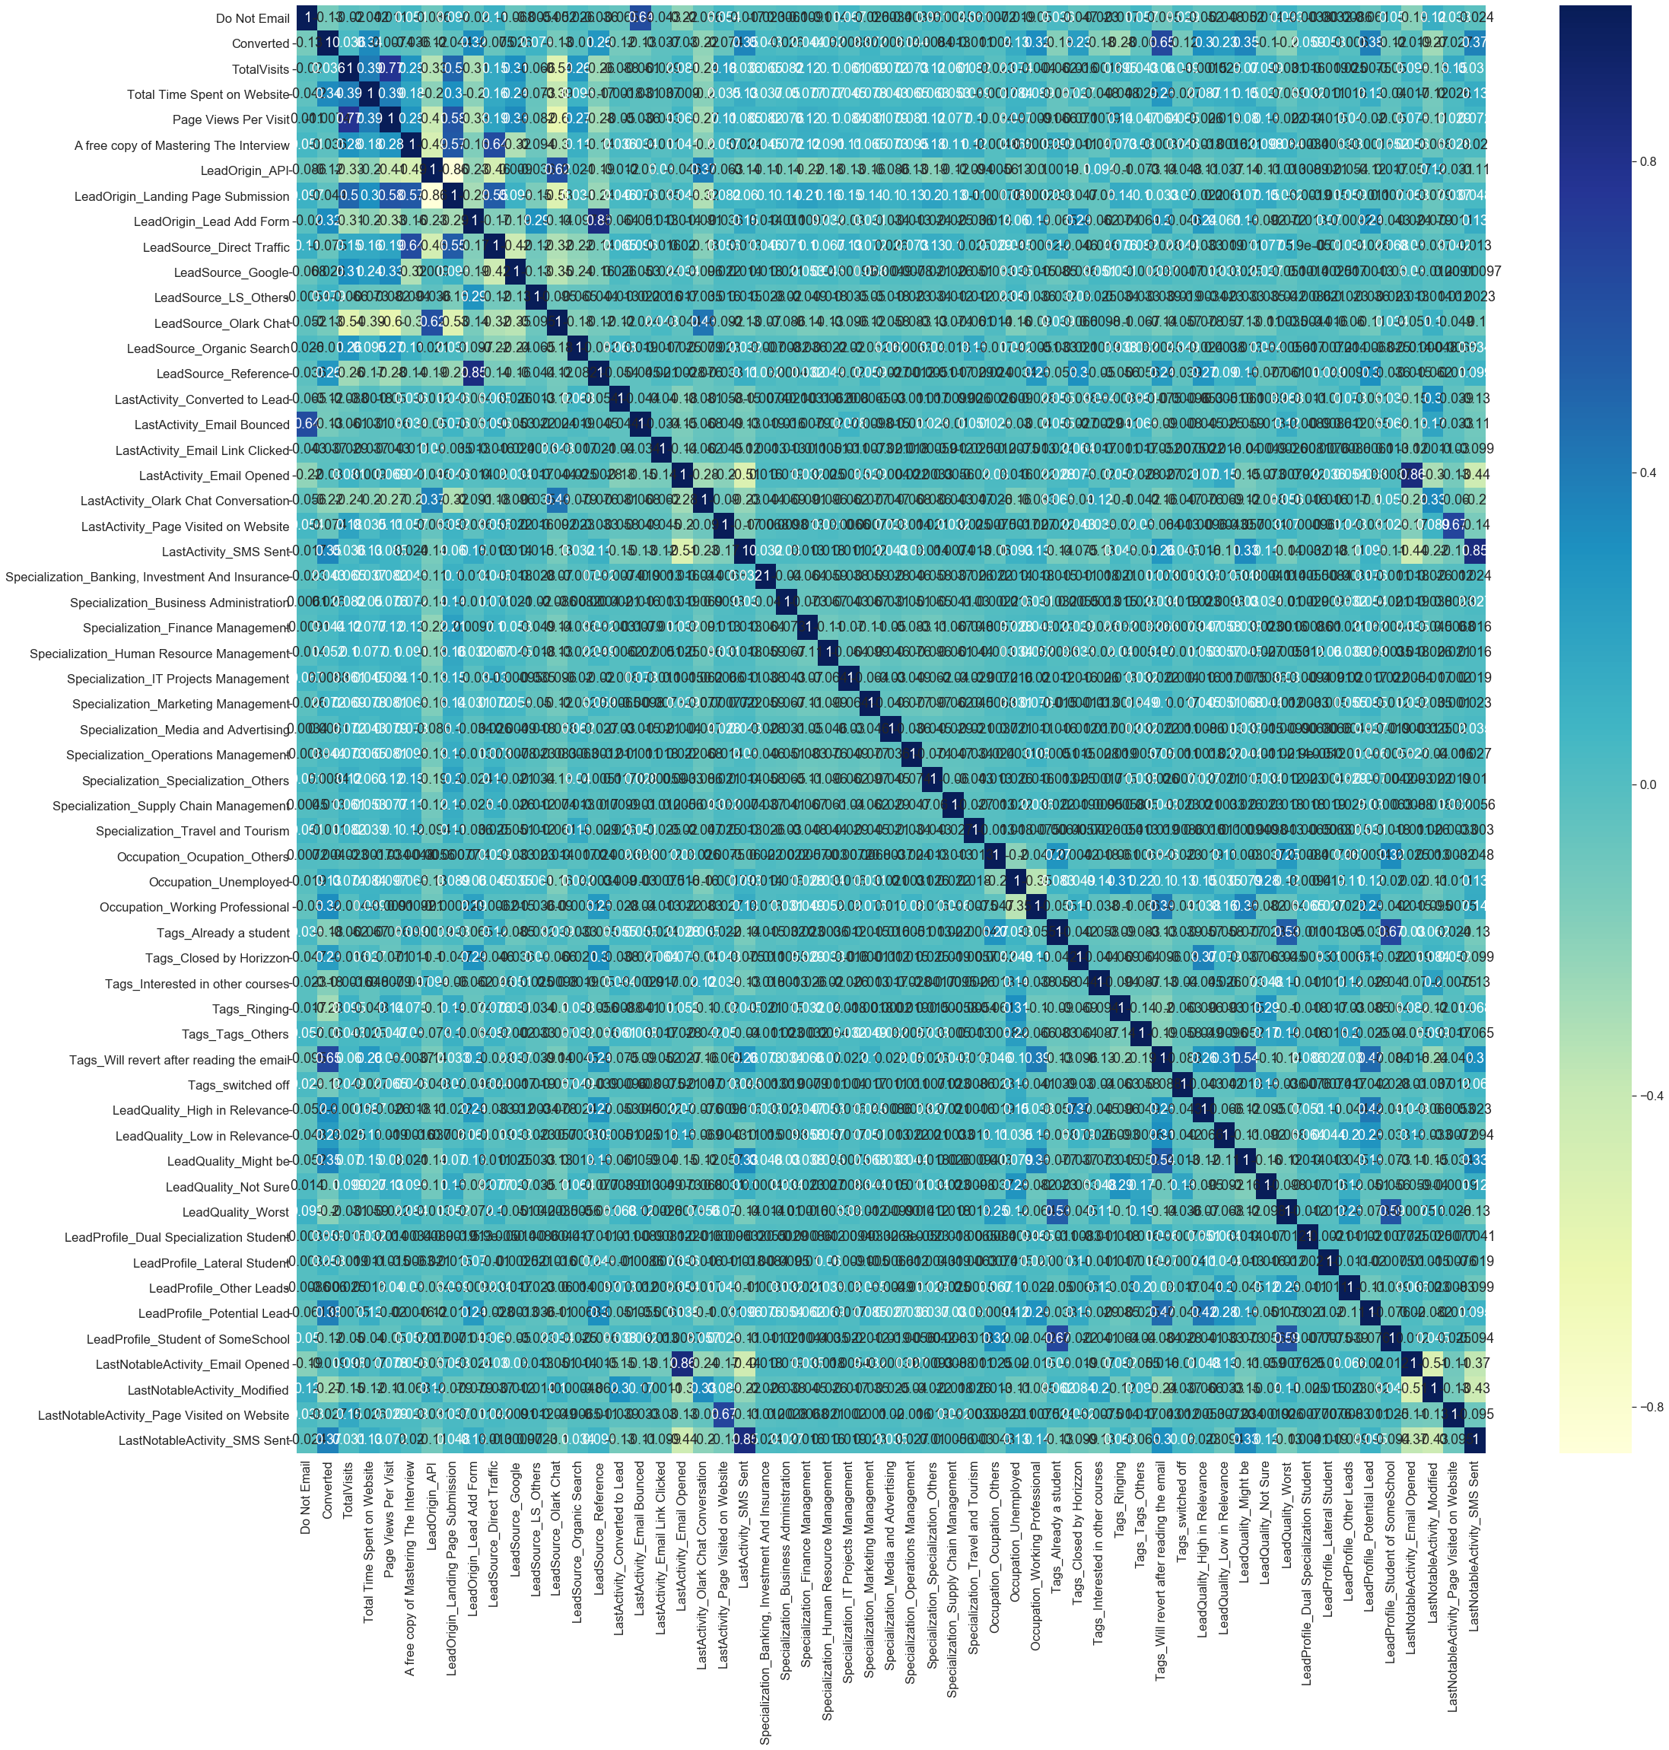

Slide 8
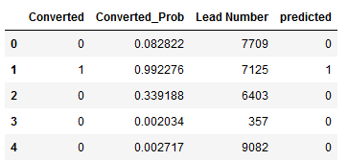
Testing model on Test Data :
Scaling of Test Data
Prediction on the Test Data
Predicted Dataset head ➔➔
Accuracy, Sensitivity and Specificity -- Test Data
Accuracy – 91% Sensitivity – 84% Specificity – 96%

Slide 9
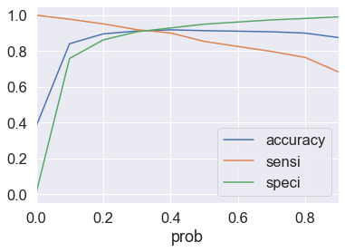
Finding Optimal Cutoff Point:
Above curve suggests the optimum point to take it as a cutoff probability.

